Slide 1
Team Number Wizards
Welcome to our fun counting game!!
Taliane, Intisar, Will, Isabel

Slide 2
Agenda
Explanation of the game
Our aims for the project
Demonstration
Little code chat

Slide 3
The Game
Game for 2 or more players
Take it in turns to count up from 0
Each player can add at most 3 to the total
Person who takes the total to 21 loses!

Slide 4
MVP
Build an API to be able to create a player, and create a game object
Store these players and games in a database (one-to-many)
Create the game logic for a single player to play against the ‘computer’
Create two game modes, easy and difficult
Easy mode would be computer adding random number between 1 and 3 to total
Difficult mode would be computer programmed with winning strategy

Slide 5
Extensions
Expand to multiplayer game - extends database to be many-to-many
Add functionality to add players to an existing game
Create ‘loserboard’ - method to return all the players ordered by the number of games they have lost
Delete functionality - remove players from game, or delete entire players and game

Slide 6
How we did it
We mobbed the whole thing
Used Trello to get started
Kept to-do lists in slack which we updated
Drew initial UML diagram and ERD for the MVP, updated these as we tackled the extensions
Wrote separate ReadMe’s for the controllers, then collated them at the end
Regular git commits and PostMan tests

Slide 7
DEMO

Slide 8
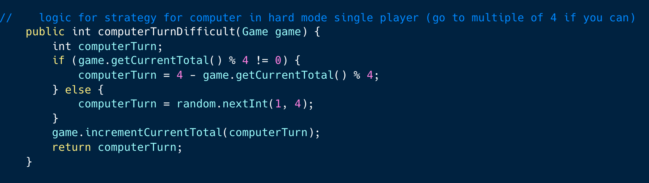
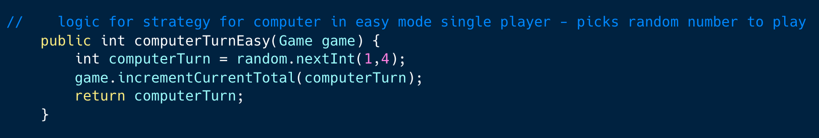
Peek behind the curtain

Slide 9
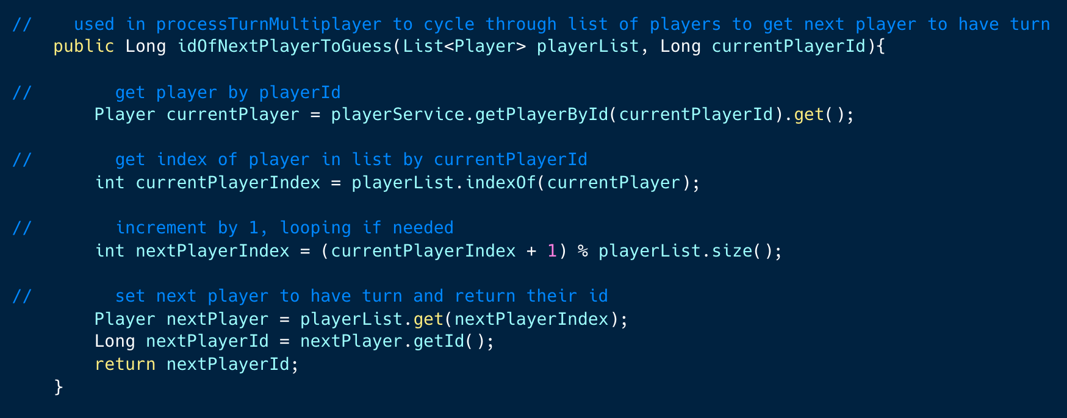
Multiplayer turn logic

Slide 10
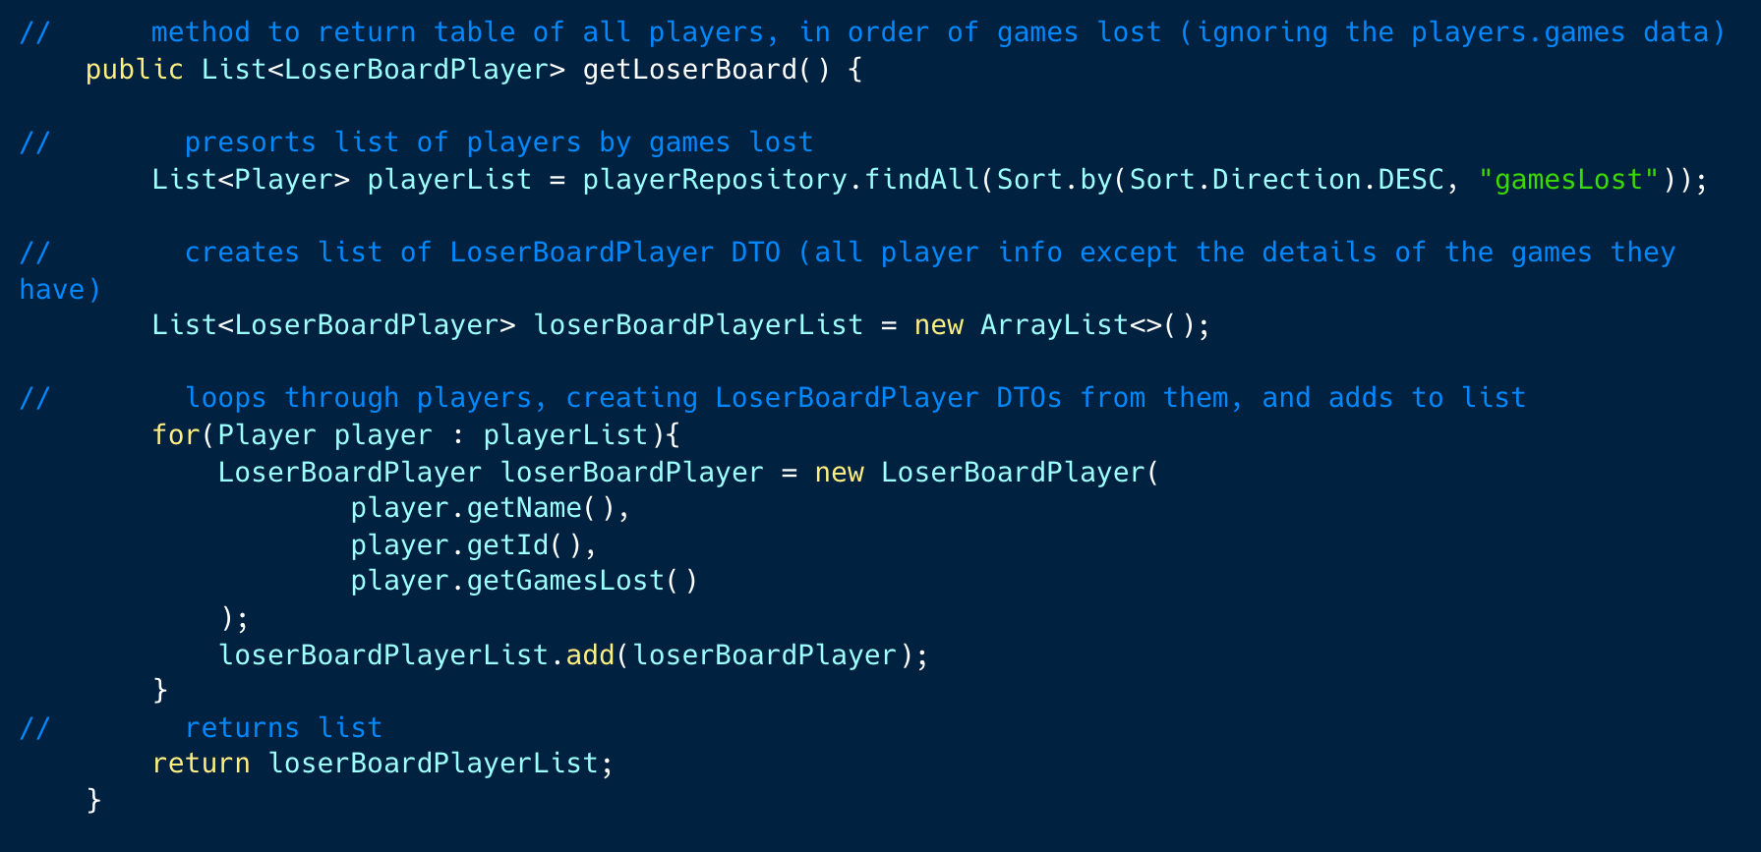
LoserBoardPlayer DTO method

Slide 11
Credits
Thanks for listening
https://github.com/williamdorling/Backend_TwentyOne_API
https://github.com/IsabelG96
https://github.com/IntisarSKD
https://github.com/TalianeM/

